Slide 1
Toronto Venue Clusters
AUTHOR: CAMILO HOYOS​
Date: 2021-02-07

Slide 2
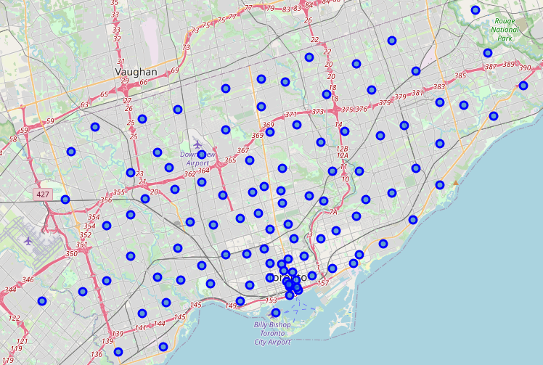
Identifying Commercial Trends
Understanding where people go and where existing stores are can help with furthering commercial operations and expansions.
By taking a glimpse into existing venue data and applying Machine Learning practices, we can extract insight from public venue data.
With further analysis, more data points can be provided to make better decisions

Slide 3
Data Sources and Data Wrangling
General location information to gather meaningful naming such as borough and neighborhood was scraped from Wikipedia.
General location sourced longitude and latitude was sourced from Coursera documentation
Venue spatial information and venue categorization was queried using Foursquare’s public API.
All records with no values or duplicates were removed to not pollute the data set.
One hot encoding was utilized to count and evaluate venue categorizations.

Slide 4
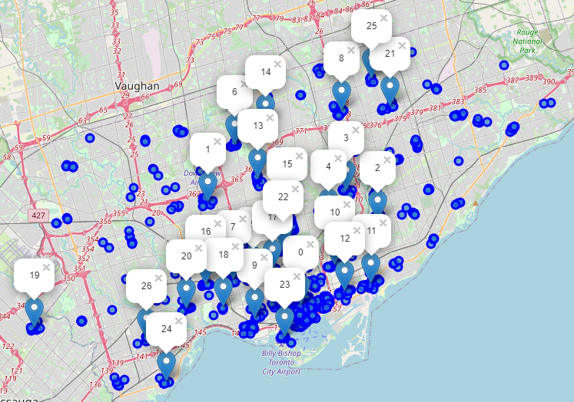
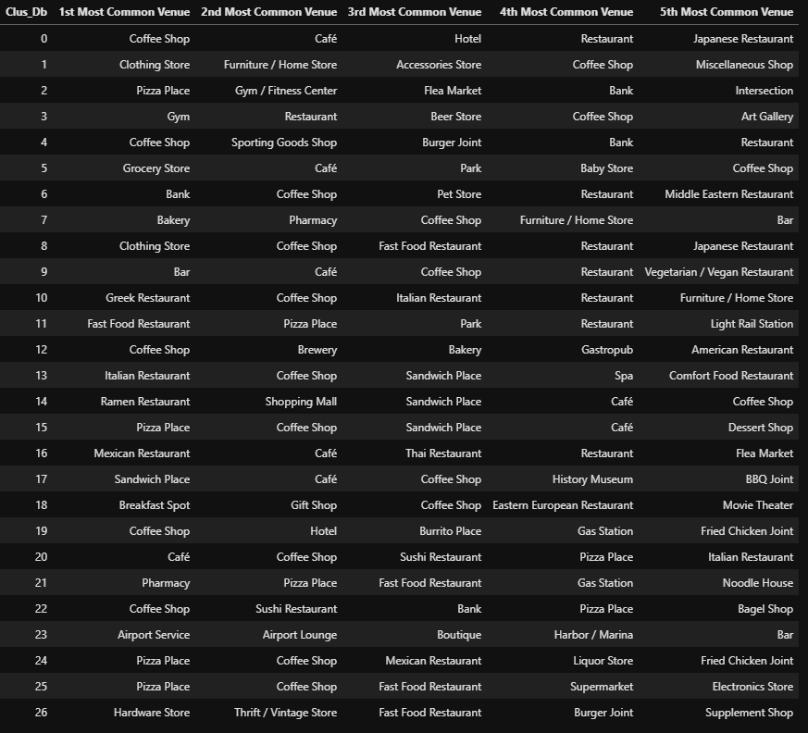
General Clustered Results
Spatial Clusters
Cluster Top Venues
(Provided in Appendix)

Slide 5
Conclusion and Future Analysis
It is clear that restaurants, pizza places, and coffee shops thrive in Toronto. Desire to open any of these shows general success. Perhaps identifying clusters that do not contain these as top 5 venues would generate more revenue due to lack of spatial competition.
Nightlife, art and entertainment is generally missing. An untapped market that could potentially need evolution to thrive.
Bars, retail stores, parks, and bakeries generally do well. Seems to be a market that could be disrupted.
Additional analysis with customer data, travel data, revenue, and ratings could drastically increase the value of this report.

Slide 6
Thank you

Slide 7
Appendix A

Slide 8
Appendix B

